Slide 1



Multi-Task Learning for Location Estimation Using RSSI of Wireless LAN in NLoS Environment TeleAILab 2022-Dec-01
Notes:
Multi-task learning
Rising

Slide 2
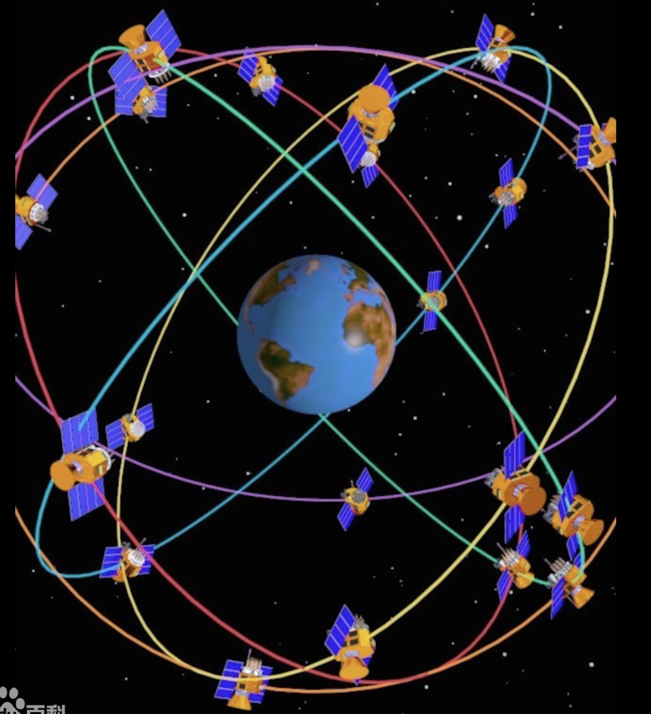
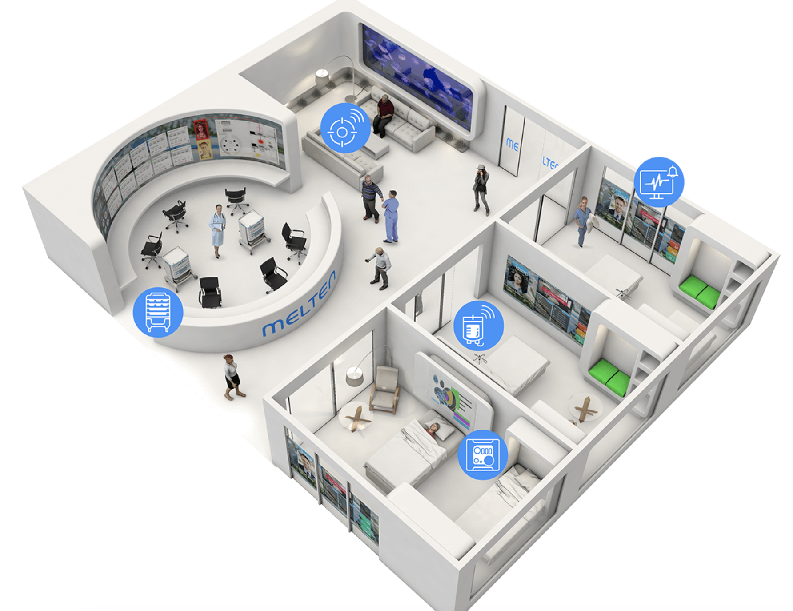
Background
Outdoor location recognition Indoor location estimation
People tracking in shopping malls, robot localization, autonomous car parking…
Line of Sight (LoS)
Non Line of Sight (NLoS)
Credit to: https://baike.baidu.com/pic/全球定位系统/1240960
Credit to: http://www.hkzbai.com/show-10-51-1.html
Notes:
Global Navigation Satellite System (GNSS) requires a direct LOS and the connection to at least 4 satellites simultaneously. It has a large position error and blocks signals on buildings and walls for indoor environment.
Non-line of sight (NLOS) refers to the path of propagation of a radio frequency (RF) that is obscured (partially or completely) by obstacles
Terminalogy: LoS/Nlos APs RSSI/RFID/Bluetooth have been studied for indoor location recognition.
Indoor location-based service is promising, such as smart retail

Slide 3
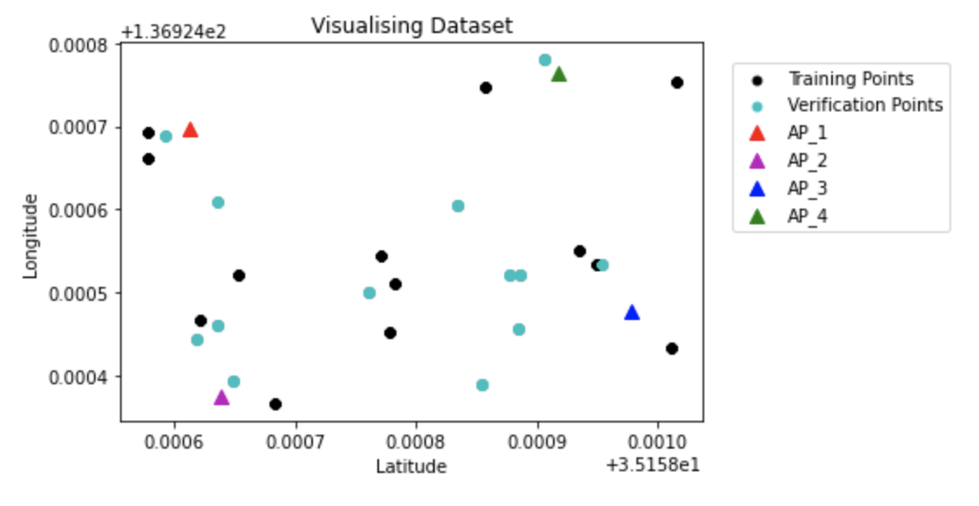
Problem description
Received Signal Strength Indication (RSSI) refers to access point (AP)
LoS/NLoS environment
Notes:
- 4 access points
Points with RSSI from corresponding Aps
Latitude & longitude
To estimate latitude and longitude for verification points with given RSSI

Slide 4
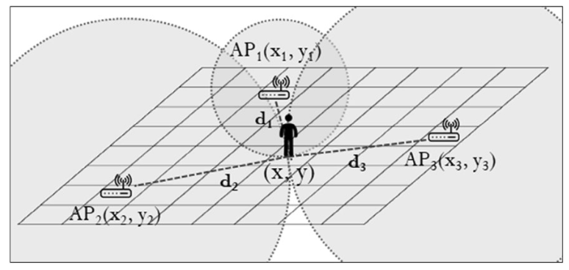
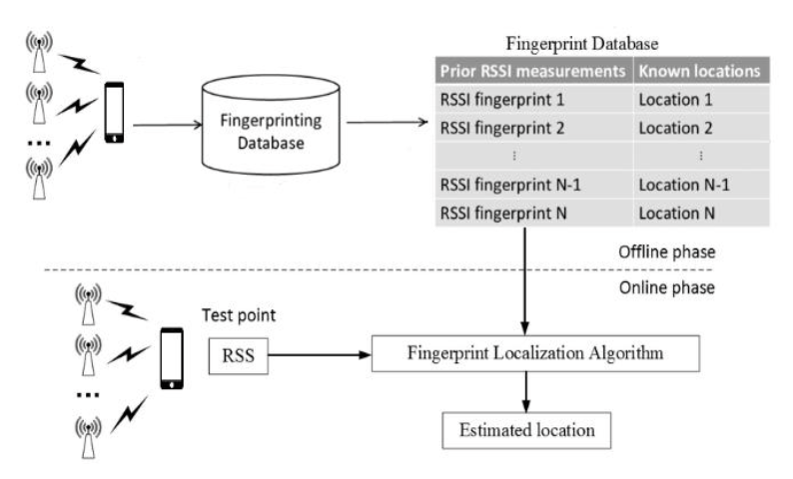
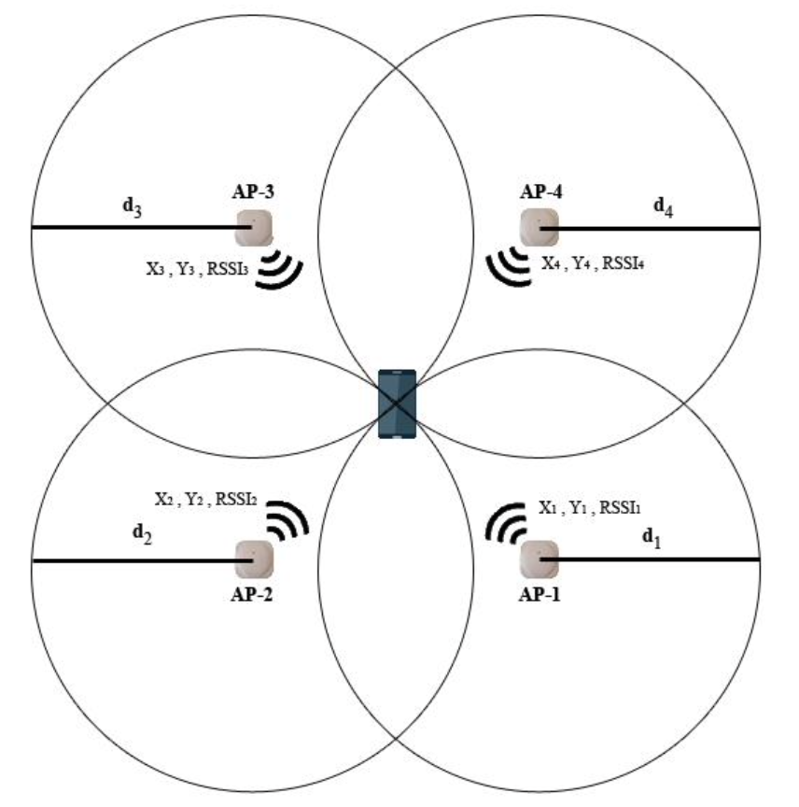
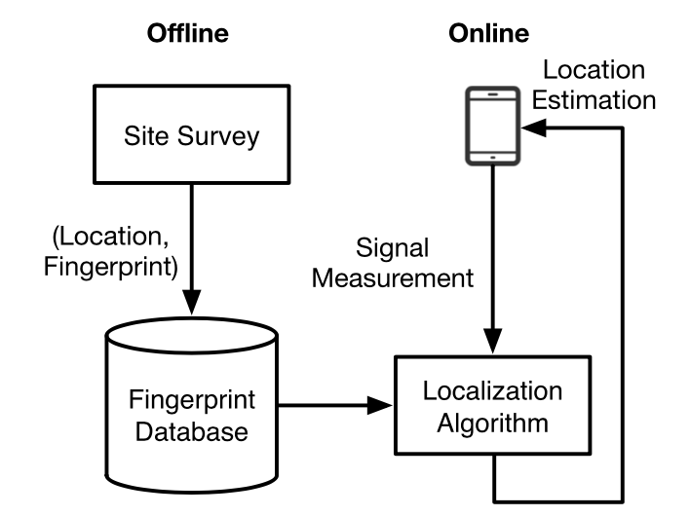
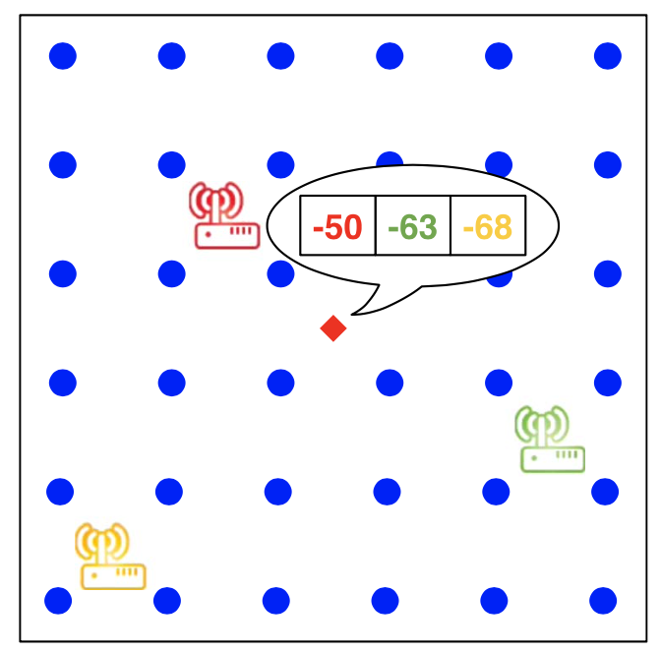
Motivation
RSSI is inversely proportional to the distance to the power of a path loss exponent.
Wi-Fi fingerprinting is usually conducted in two phases: an offline survey and an online query.
Triangulation/Trilateration
Fingerprint
Credit to: Ilci et al. “Trilateration Technique for WiFi-Based Indoor Localization”
Credit to: Khokhar et al. “Machine Learning-Based Indoor Localization using Wi-Fi and Smartphone”
Credit to: Lee et al. “Random forest and WiFi fingerprint‐based indoor location recognition system using smart watch
”
Credit to: He et al. “Wi-Fi Fingerprint-Based Indoor Positioning:
Recent Advances and Comparisons
”
Notes:
Recently, fingerprint-based methods drawn lots of attentions.
Green -> blue

Slide 5
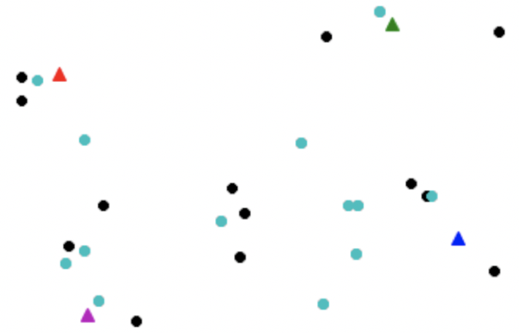
Motivation
RSSI is inversely proportional to the distance to the power of a path loss exponent.
Wi-Fi fingerprinting is usually conducted in two phases: an offline survey and an online query.
Triangulation/Trilateration
Fingerprint
Credit to: Ilci et al. “Trilateration Technique for WiFi-Based Indoor Localization”
Credit to: Khokhar et al. “Machine Learning-Based Indoor Localization using Wi-Fi and Smartphone”
Credit to: Lee et al. “Random forest and WiFi fingerprint‐based indoor location recognition system using smart watch
”
Credit to: He et al. “Wi-Fi Fingerprint-Based Indoor Positioning:
Recent Advances and Comparisons
”
Notes:
Recently, fingerprint-based methods drawn lots of attentions.
Green -> blue

Slide 6
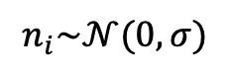
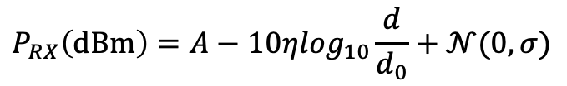
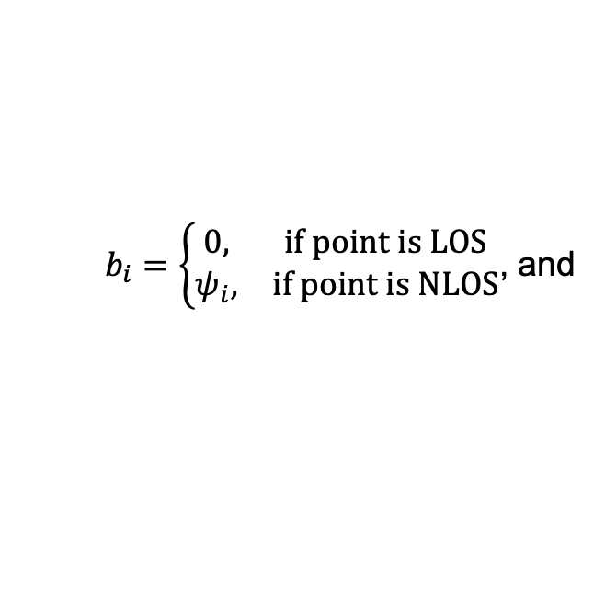
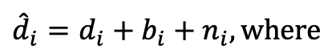
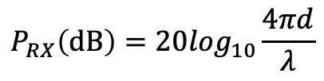
Historical methodology
RSSI is inversely proportional to the distance to the power of a path loss exponent.
Lognormal model
$$P_{RX}\left(dBm\right)=A−10η\log_{10}\frac{d}{d_{0}}+𝒩(0,σ)$$
Frii’s formula
$$P_{RX}\left(dB\right)=20\log_{10}\frac{4πd}{λ}$$
FSPL
$$P_{RX}\left(dBm\right)=20\log_{10}d+20\log_{10}f−22.55$$
$b_{i}=\left\{\begin{matrix}0, & if point is LOS \\ ψ_{i}, & if point is NLOS\end{matrix}\right.$, and
$${\hat{d}}_{i}=d_{i}+b_{i}+n_{i}, where$$
$$n_{i}\sim 𝒩(0,σ)$$
Notes:
Theoretical studies on RSSI-distance relationships
LOS/NLOS can be considered through a bias term
Historical analysis/methodology

Slide 7
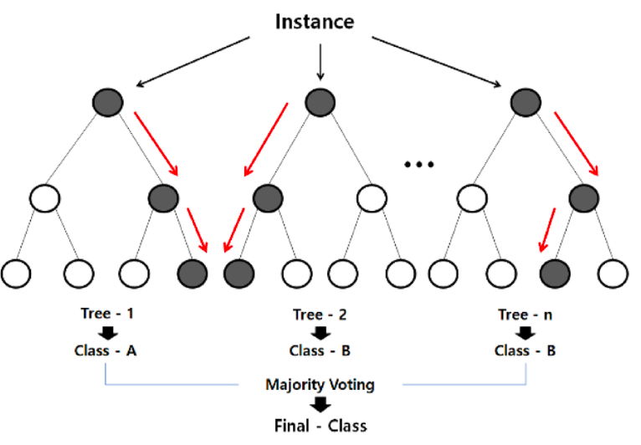
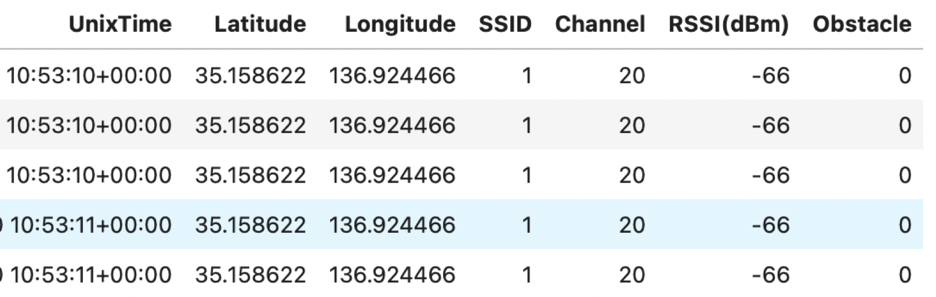
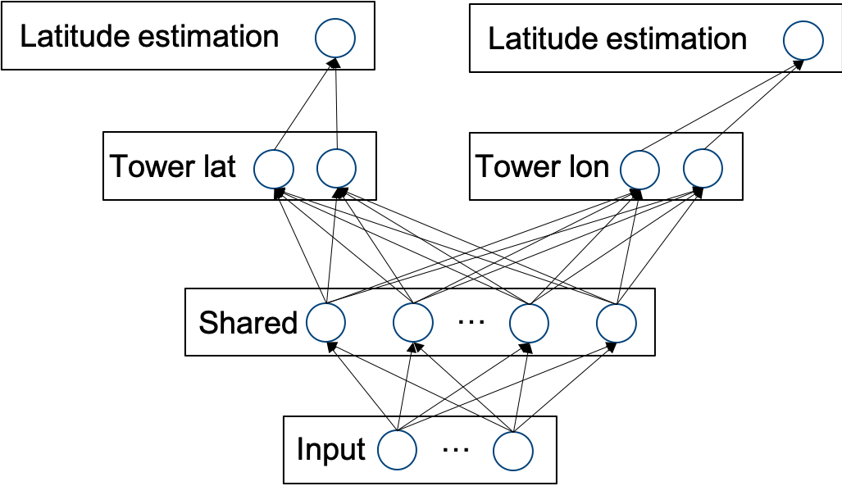
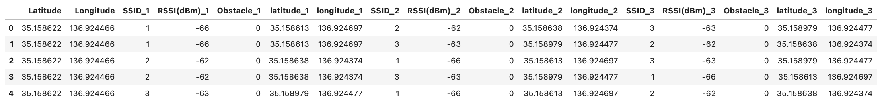
Our Solution
Our solution includes of three key steps.
Data Processing Location Estimation Evaluation
Processing
v.s.
Statistics
Mean error (m)
Maximum error (m)
Modeling
Notes:
Modeling separasion.
MTL network visulization and introduction
re-orgnize

Slide 8
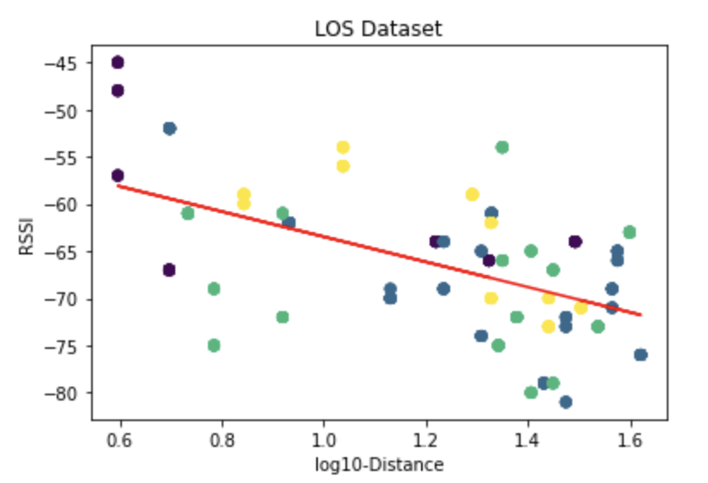
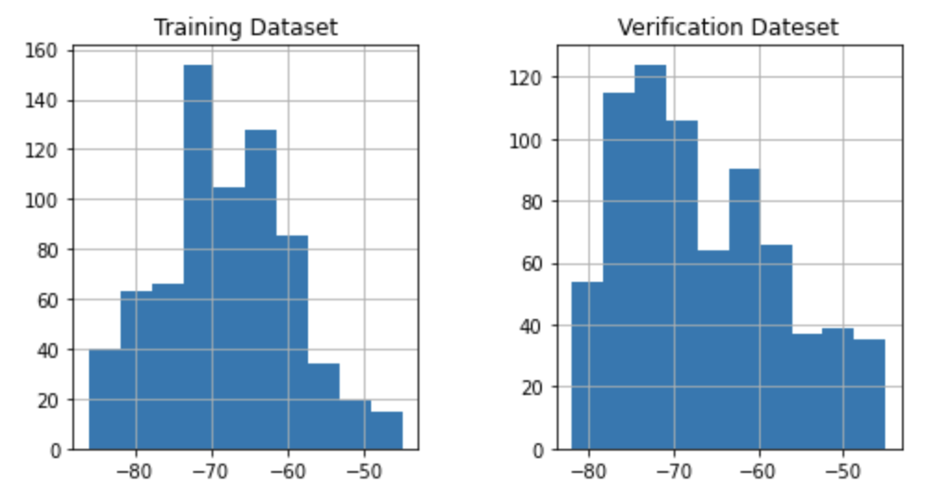
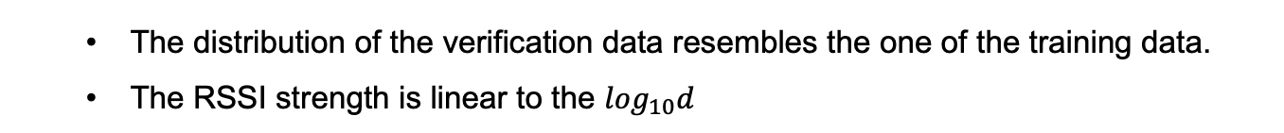
Our Solution – Data Processing
The distribution of the verification data resembles the one of the training data.
The RSSI strength is linear to the $\log_{10}d$
Notes:
Investigate RSSI-distance relations

Slide 9
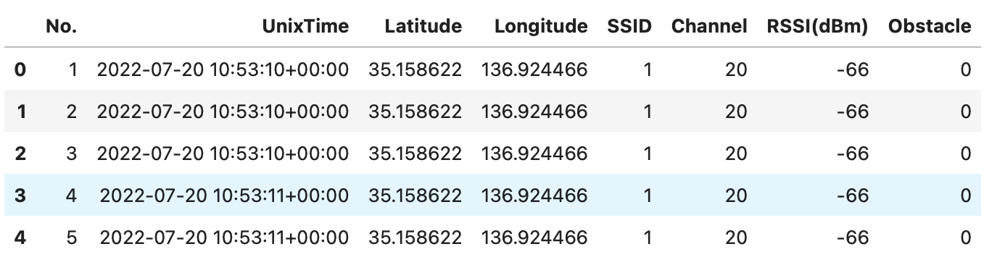
Our Solution – Data Processing
No. offers little information, Channel contains constant values.
There are duplicated samples, and little fluctuation with time.
Notes:
Channel: constant, remove
Positional information
LOS/NLOS
Temporal information is useless

Slide 10
Our Solution – Data Processing
Augment data by permute the order the APs.
Notes:
Ways of data augmentation.

Slide 11
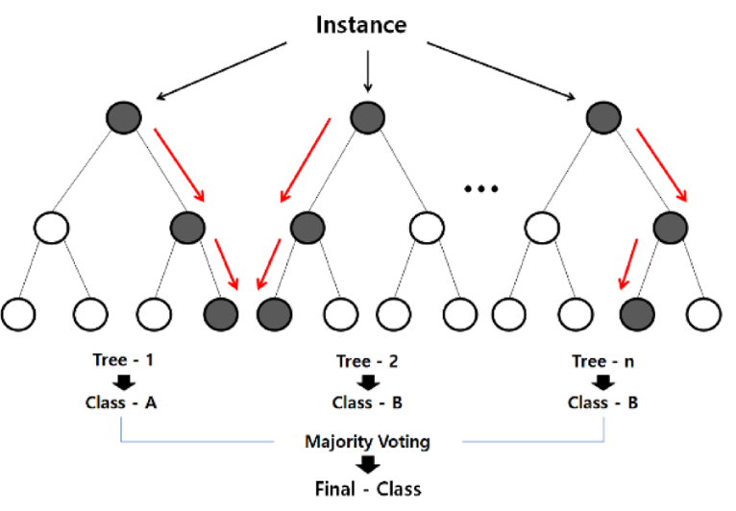
Our Solution – Location Estimation – Tree models
XGBoost
Latitude
Random Forest
Longitude
Extra Tree Regression
Two models are necessary to predict latitude and longitude, respectively.
Notes:
Two models to predict latitude and longitude, individually.

Slide 12

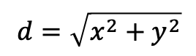
Our Solution – Location Estimation – Multi-task learning
Tower
Lat
Input
Shared
Latitude estimation
…
…
…
…
…
Longitude estimation
Tower
Lon
Explanation:
Latitude
Predict latitude and longitude
in one model
RSSI
Distance
Longitude
$$P_{RX}\left(dBm\right)=A−10η\log_{10}\frac{d}{d_{0}}+𝒩(0,σ)$$
Trilateration/Triangulation
$$d=\sqrt{x^{2}+y^{2}}$$
Notes:
One model to predict the position.
Stein’s paradox: estimating the means of three or more Gaussian random variables using samples from all of them could yield better performance than estimating them separately
Model interpretation

Slide 13
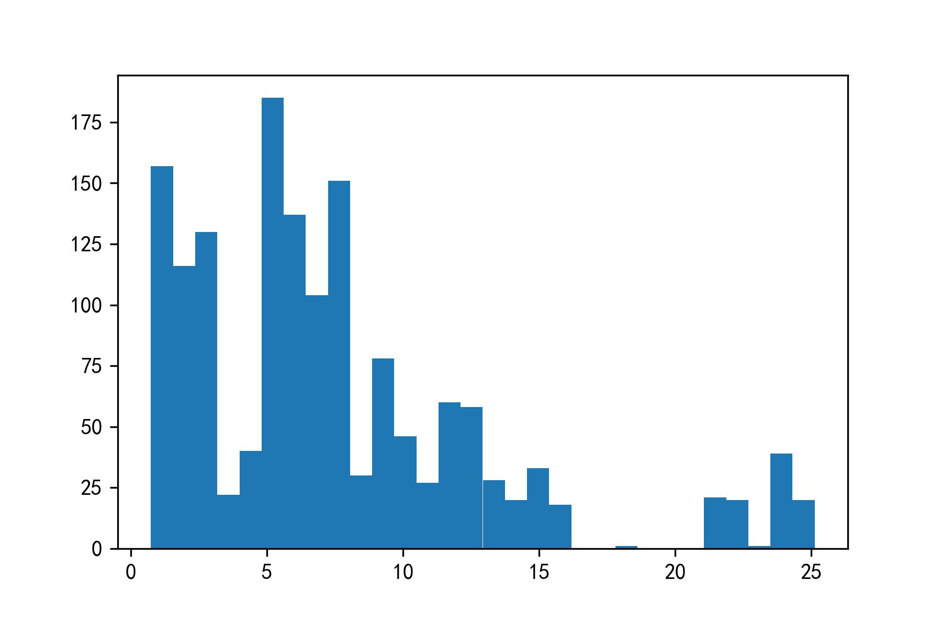
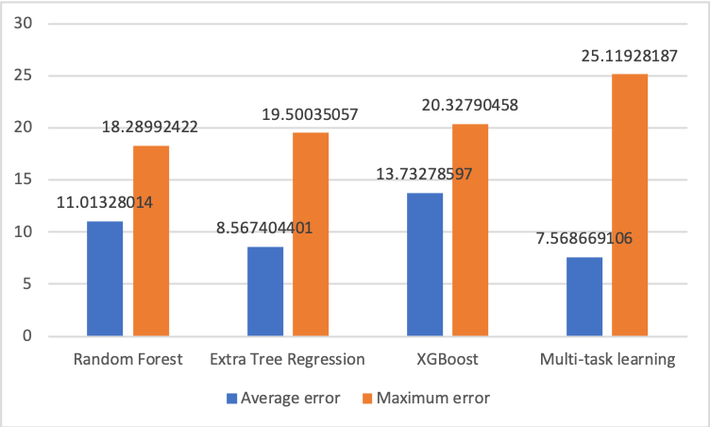
Our Solution – Results
Multi-task learning model obtains the best mean error.
Most predictions of the multi-task learning model are relatively good.
Count
error
Notes:
直方图形式
还需要另加多任务优化图

Slide 14
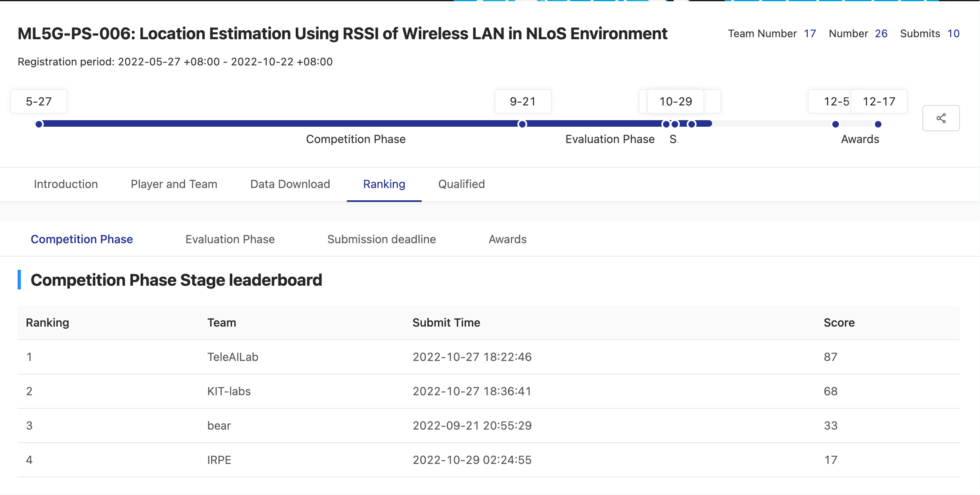
Our Solution – Results
Notes:
直方图形式
还需要另加多任务优化图
Conclusion: augmentation + mtl (mining)

Slide 15
Outlook
Explicit usage of LoS/NLoS information
Spatial dependencies
Dynamics
6G
Notes:
Conclusion + outlook
6G application/ emphasize application value

Slide 16
Thank you!

Slide 17
Latitude estimation
Latitude estimation
Tower lat
Tower lon
Shared
…
Input
…

